Slide 1
Recipe for Modern Applications: .NET, Azure SQL, Functions, Geospatial, JSON
Anna Hoffman
Data & Applied Scientist / Program Manager
Microsoft Azure Data
Notes:
*Davide runs to catch the bus and he misses it*
D: Oh hi there, I’m Davide Mauri, PM on Azure Data. I just missed the bus. I’ve got some time before the next one, so I’m going to call my colleague Anna Hoffman
*walks inside and calls Anna on Teams*
*Title slide shows on screen to cut to inside scene*
A: Hey Davide, what’s up?
D: *explains scenario* I wish there was a way I could be notified when the bus was close so I would leave my office on time!
A: Actually, there might be a way

Slide 2





Catching (or not catching) the bus
☹
Modern apps
Azure SQL Database
Catch the bus
Summary
What’s new

Slide 3





Catching the bus
☺
Modern apps
Azure SQL Database
Catch the bus
Summary
What’s new

Slide 4
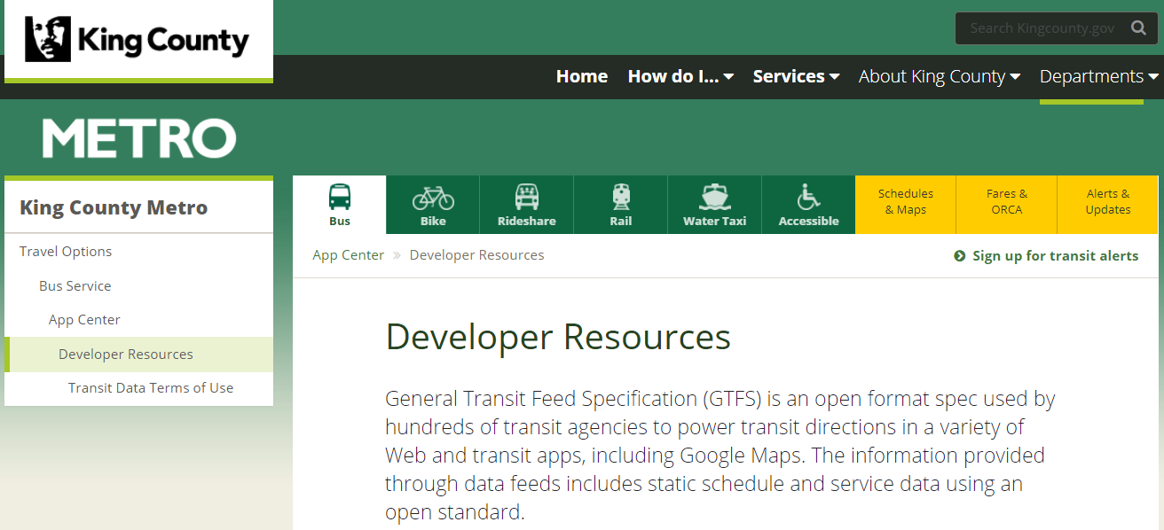
Goal: Integrate Public Transportation Data
Sources are:
Flat File with Route Reference Data
JSON File in GTFS format with Real-Time Vehicle Positions
https://kingcounty.gov/depts/transportation/metro/travel-options/bus/app-center/developer-resources.aspx
Modern apps
Azure SQL Database
Catch the bus
Summary
What’s new
Notes:
A: There is this open data set that contains all the real time bus positions that is available for free in Seattle and King County area, but many cities offer it
A: You could pull down the feed and do some geospatial queries to understand when the bus is almost arriving, e.g. entering a geo fence

Slide 5
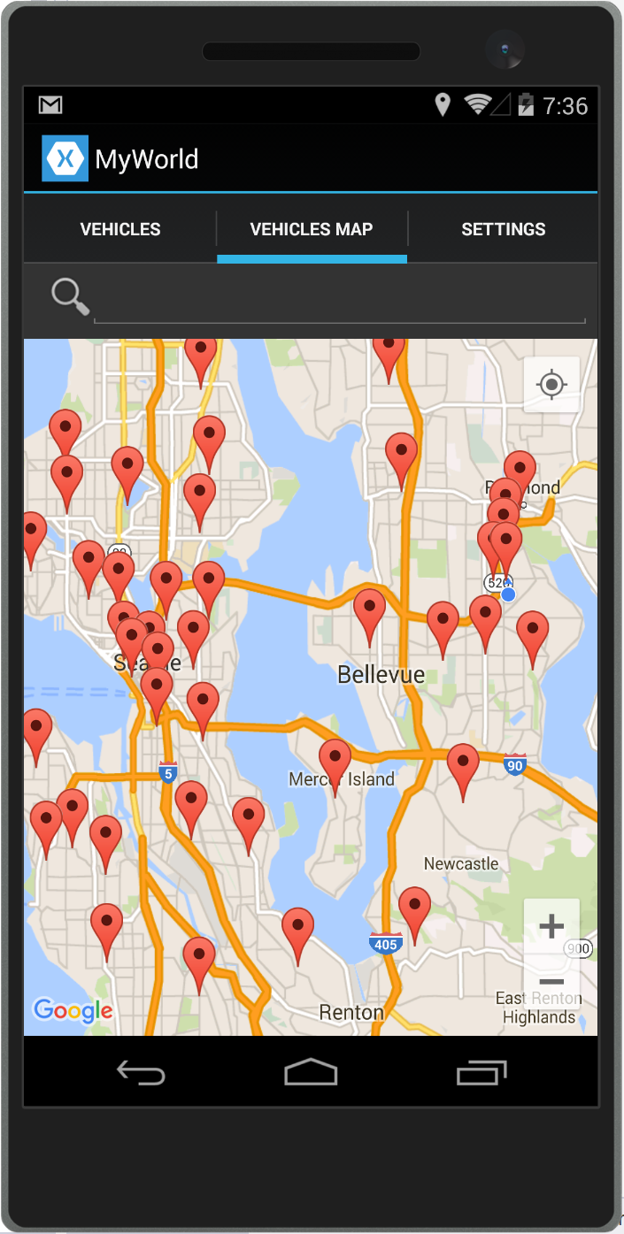
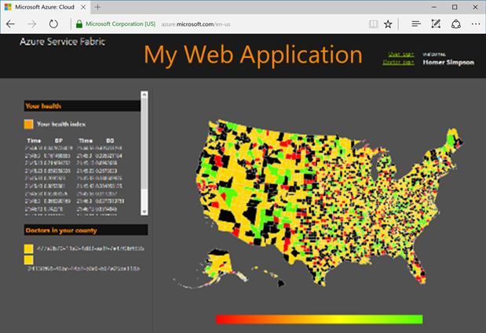
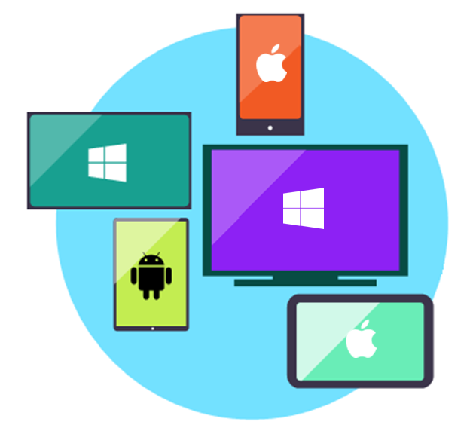
Microservices
Web presentation services
Mobile apps
Stateless services
Stateful services
Stateless services with
separate stores
Modern apps
Azure SQL Database
Catch the bus
Summary
What’s new
Notes:
D: Yes, that’s a good idea. I will think about that. Couple services that need to be created. Want to use a microservices approach to service an app and a website. *explain briefly what you want the app to do and why microservices*

Slide 6
Microsoft Azure for modern app development
CONTROL
PRODUCTIVITY
VMs
Azure Virtual Machines
Containers
Azure Kubernetes Service | Azure Red Hat OpenShift | AI services
PaaS/Serverless
App Service | Functions | Logic Apps Spring Cloud | AI Services
Low code
Power Apps | AI Builder Azure services
Managed databases
Azure SQL Database | PostgreSQL | MySQL | Azure Cosmos DB
DevOps
GitHub | VS Code
Azure Arc | Azure Stack
Cloud
Edge
Modern apps
Azure SQL Database
Catch the bus
Summary
What’s new
Notes:
Think you could use Microsoft Azure for modern applications.
A: Whether your goal is to modernize apps, build cloud native apps, collaborate and contribute to open source, integrate Data & AI to your apps, rapidly build apps with low code platforms, or use a little bit of DevOps, Azure provides developers with the right tools for the right job to get the work done.
D: OK cool, sure, I can use Azure for this. Couple services that need to be created. Probably need a document DB, then a geospatial library to figure out if a bus is in a geofence, etc.
A: Yeah you could probably do that, but you don't need to overcomplicate things, you can just use Azure SQL. Let me tell you about it

Slide 7



Azure SQL
A unified SQL portfolio built on the industry-leading SQL Server engine
SQL Server on Azure Virtual Machines
Azure SQL Managed Instance
Azure SQL Database
Best for re-hosting and apps requiring OS-level access and control
Automated manageability features and OS-level access
Best for modernizing existing apps
Offers high compatibility with SQL Server and native VNET support
Best for building new apps in the cloud
Pre-provisioned or serverless compute and Hyperscale storage to meet demanding workload requirements
Infrastructure as a Service
Platform as a Service
Modern apps
Azure SQL Database
Catch the bus
Summary
What’s new
Notes:
A: Azure SQL is directly linked to SQL Server, an industry-leading, enterprise database. Azure SQL has three deployment options in Azure, which all leverage the same engine code base. Typically SQL Server on Azure Virtual Machines is best for solutions that want to migrate to the cloud quickly and might need access to the OS. This has great benefits and is known as IaaS. We also have two PaaS offerings, MI, which gives you essentially a managed SQL Server, and DB, which gives you just a database and has the latest cloud innovations. Both PaaS options are versionless, too, so you never have to worry about updating SQL again. I think you’ll like SQL DB for this.
D: This is cool, but I’m not sure a relational model can really fit this model I have.
A: au contraire!! Let me tell you more about SQL DB.

Slide 8
Azure SQL Database is the best database for modern apps
Run any workload anywhere on the industry-leading SQL Server engine
Built-in security
Versionless
Apply your current skills
Analytical processing and high-concurrency optimizations
Developer experience
Native geospatial support
Multi-model capabilities (JSON, Graph, Key-Value, XML)
Serverless and Hyperscale
Relational Engine is the backbone of everything
Modern apps
Azure SQL Database
Catch the bus
Summary
What’s new
Notes:
A: I think SQL DB is the best database for modern applications.
A: Yes, this is a Relational Engine, but that gives you the ability to formally analyze, rewrite, and optimize queries. So aside from the obvious support to relational model that SQL DB supports (things like tables, columns, joins, set-based operations, predicates …), SQL DB also has multi-model capabilities, native geospatial support, and great scaling and cost optimization properties.
D: OK this is interesting, it can be used to optimize non-relational features (as at the end of day we’re always dealing with sets of data). Let me look into it and I’ll call you back
*fade out*

Slide 9
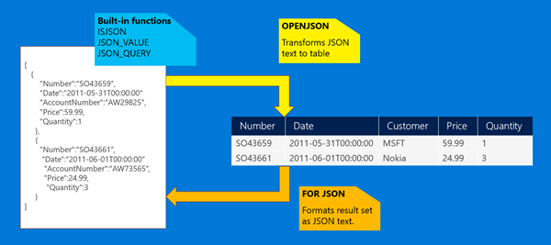
Azure SQL Database supports JSON
Storage, manipulation and creation of JSON documents supported
Modern apps
Azure SQL Database
Catch the bus
Summary
What’s new
Notes:
D: So I looked into the capabilities and this is what I learned. *explains JSON*

Slide 10
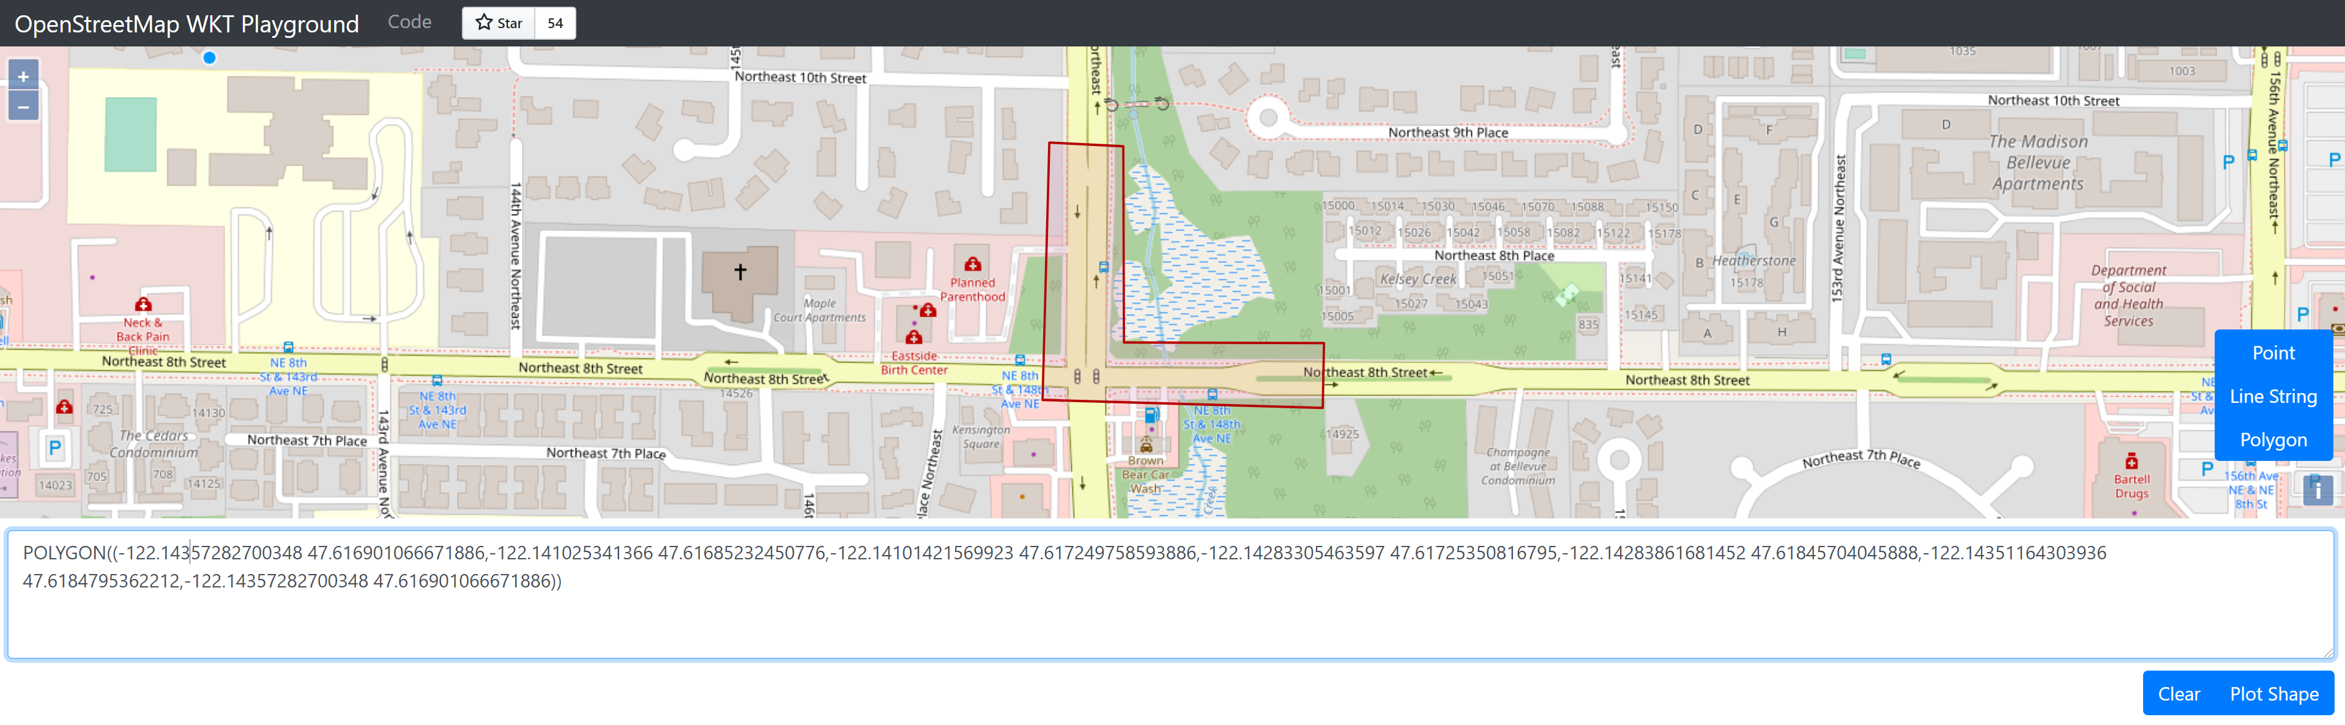
Azure SQL Database supports Spatial
Modern apps
Azure SQL Database
Catch the bus
Summary
What’s new
Notes:
D: *Explains geospatial support* *Sets up demo*

Slide 11





Catch the bus
Bus
IoT Device
JSON
TDS
JSON
Azure SQL
T-SQL
Azure Storage
Route Reference Data
Notes:
D: Azure SQL DB is really cool, pretty easy to manage. Supports JSON, Geospatial, as well as connecting to other services.
D: I put together a sample architecture for what I’m thinking Anna. *Explains the architecture*.
D: I like SQL DB. But I’m worried this is going to cost me a lot, especially just for me to use.

Slide 12
JSON and Geospatial support in Azure SQL Database
Demo
Notes:
D: *demo*
JSON Source Data (Metro GTFS)
JSON in AzureSQL
Geospatial in Azure SQL
- Find if a point is contained into a shape -> Geofence!
*Show the Azure functions reading from database easily. Execute geofencing procedure calculation. Sending back and forth JSON. As a dev it's very easy*

Slide 13
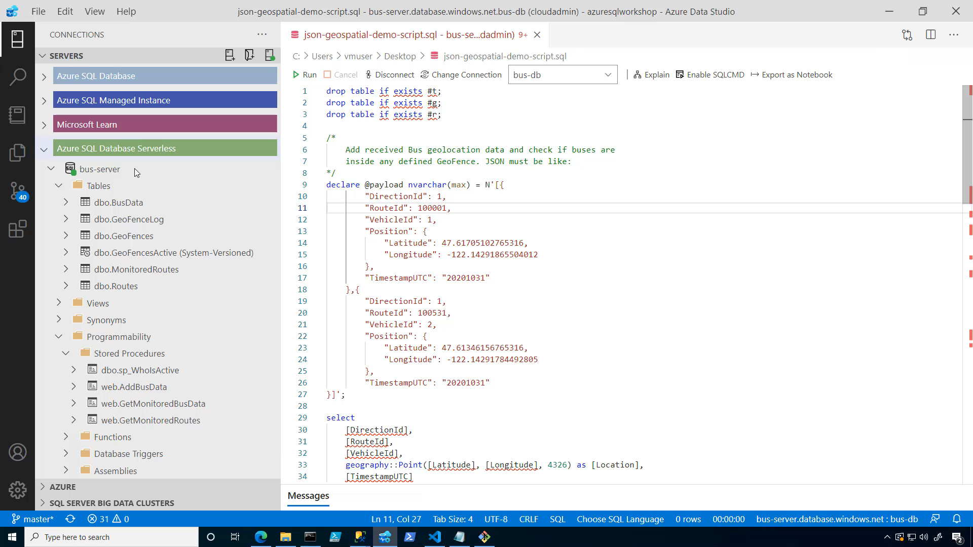
JSON and Geospatial support in Azure SQL Database
Demo
Notes:
D: *demo*
JSON Source Data (Metro GTFS)
JSON in AzureSQL
Geospatial in Azure SQL
- Find if a point is contained into a shape -> Geofence!
*Show the Azure functions reading from database easily. Execute geofencing procedure calculation. Sending back and forth JSON. As a dev it's very easy*

Slide 14
JSON and Geospatial support in Azure SQL Database
Demo
Notes:
D: *demo*
JSON Source Data (Metro GTFS)
JSON in AzureSQL
Geospatial in Azure SQL
- Find if a point is contained into a shape -> Geofence!
*Show the Azure functions reading from database easily. Execute geofencing procedure calculation. Sending back and forth JSON. As a dev it's very easy*

Slide 15
Azure SQL Database Serverless
CPU usage
Line of business apps
Expense reporting and employee tracking apps
Procurement systems
4
E-commerce
Opening new marketplaces, marketing campaigns, sales promotions
Inactive
Paused
Number vCores
1
Dev/test workloads
Handling unpredictable workload needs
0
1:00
4:00
5:00
8:00
8:00
9:00
10:00
11:00
12:00
13:00
14:00
15:00
16:00
17:00
18:00
19:00
20:00
21:00
22:00
23:00
0:00
2:00
3:00
6:00
7:00
Min vcores
Max vcores
Vcores used
Vcores billed
Modern apps
Azure SQL Database
Catch the bus
Summary
What’s new
Notes:
A: I think you probably want to start with serverless, for a few reasons. *explains serverless briefly*
D: Oh nice, great. But I also think I might be on to something with this catch the bus app. Maybe this could be my new startup and even the next unicorn! So I want a modern scalable database that's also distributed. I looked into it, and it seems like if my business takes off, I can use the Hyperscale database.
D: Ask Anna how easy is to migrate to Hyperscale

Slide 16

Azure SQL Database Hyperscale
Azure SQL rearchitected from the ground-up as a set of collaborating, distributed services
Compute
Storage
Log
Supports 100TB+
Read-Write
Read-Only
Compute nodes
Primary Compute
Secondary Compute
Secondary Compute
SqlServr.exe
SqlServr.exe
SqlServr.exe
Log Service
RBPEX Data Cache
RBPEX Data Cache
RBPEX Data Cache
Landing Zone
(Azure Premium Storage)
Page Servers
Log Service
Long term log storage for PITR (Azure Standard Storage)
Log Cache
Page Server
Page Server
…
Page Server
RBPEX Data Cache
RBPEX Data Cache
RBPEX Data Cache
Data File
Data File
Data File
Data Pathway
Log Pathway
Snapshots
Snapshots
Snapshots
Local SSD Cache
RBPEX
Resilient Buffer Pool Extension
Azure Standard Storage
Modern apps
Azure SQL Database
Catch the bus
Summary
What’s new
Notes:
D: Cool but when I will be taking over the world with my app, I need something scalable. Something distributed that can handle any workload and scale elastically.
Davide start to describe his “dream” database, by describing the need of a separate compute and storage, and basically describe Hyperscale *without* saying the “hyperscale” word.
Highlight: distributed nature and multi-tiered cache
A: You know what? There is something that is exactly like that! Azure SQL DB Hyperscale!

Slide 17
Azure SQL Database Serverless
Demo
Notes:
A: It’s great to know you have that as an option, but don’t get ahead of yourself Davide (lol). I worked out an example for you using serverless.
A: *short demo*
Show IFTTT
D: Wow cool. But it’s all done in .NET. What if I want to build the front end of the app with something like Vue.js or another language? And I also want to deploy with GitHub because our team is using that for everything

Slide 18
Azure SQL Database Serverless
Demo
Notes:
A: It’s great to know you have that as an option, but don’t get ahead of yourself Davide (lol). I worked out an example for you using serverless.
A: *short demo*
Show IFTTT
D: Wow cool. But it’s all done in .NET. What if I want to build the front end of the app with something like Vue.js or another language? And I also want to deploy with GitHub because our team is using that for everything

Slide 19
Azure SQL Database Serverless
Demo
Notes:
A: It’s great to know you have that as an option, but don’t get ahead of yourself Davide (lol). I worked out an example for you using serverless.
A: *short demo*
Show IFTTT
D: Wow cool. But it’s all done in .NET. What if I want to build the front end of the app with something like Vue.js or another language? And I also want to deploy with GitHub because our team is using that for everything

Slide 20
Catch the bus
Bus
IoT Device
JSON
TDS
JSON
Azure SQL
T-SQL
Azure Storage
Route Reference Data
Notes:
D: Azure SQL DB is really cool, pretty easy to manage. Supports JSON, Geospatial, as well as connecting to other services.
D: I put together a sample architecture for what I’m thinking Anna. *Explains the architecture*.
D: I like SQL DB. But I’m worried this is going to cost me a lot, especially just for me to use.

Slide 21



Catch the bus
Bus
IoT Device
JSON
Azure Functions
Azure Logic App
Notifications via Outlook/Gmail
TDS
JSON
Azure SQL
T-SQL
Azure Storage
Route Reference Data
Notes:
D: Azure SQL DB is really cool, pretty easy to manage. Supports JSON, Geospatial, as well as connecting to other services.
D: I put together a sample architecture for what I’m thinking Anna. *Explains the architecture*.
D: I like SQL DB. But I’m worried this is going to cost me a lot, especially just for me to use.

Slide 22
Azure Functions and Logic Apps
Demo
Notes:
A: It’s great to know you have that as an option, but don’t get ahead of yourself Davide (lol). I worked out an example for you using serverless.
A: *short demo*
Show IFTTT
D: Wow cool. But it’s all done in .NET. What if I want to build the front end of the app with something like Vue.js or another language? And I also want to deploy with GitHub because our team is using that for everything

Slide 23
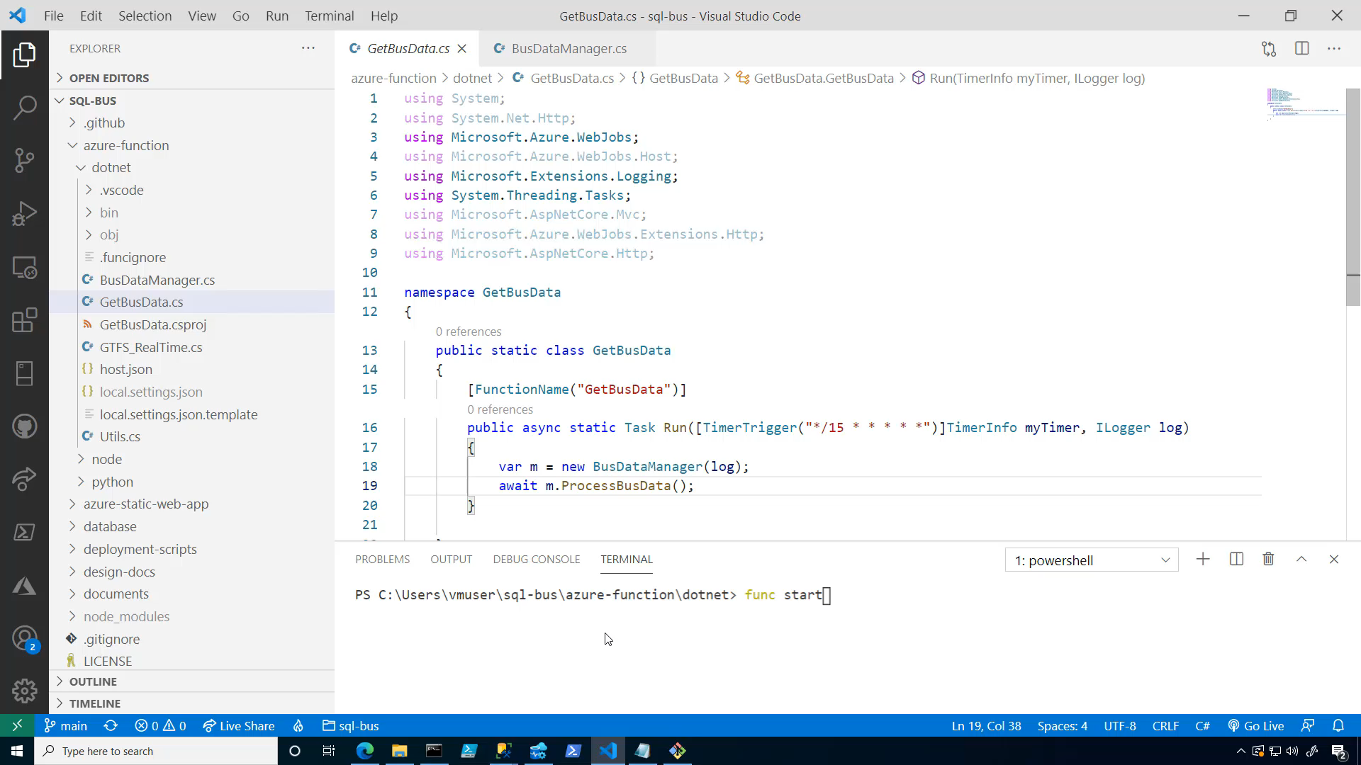
Azure Functions and Logic Apps
Demo
Notes:
A: It’s great to know you have that as an option, but don’t get ahead of yourself Davide (lol). I worked out an example for you using serverless.
A: *short demo*
Show IFTTT
D: Wow cool. But it’s all done in .NET. What if I want to build the front end of the app with something like Vue.js or another language? And I also want to deploy with GitHub because our team is using that for everything

Slide 24
Azure Functions and Logic Apps
Demo
Notes:
A: It’s great to know you have that as an option, but don’t get ahead of yourself Davide (lol). I worked out an example for you using serverless.
A: *short demo*
Show IFTTT
D: Wow cool. But it’s all done in .NET. What if I want to build the front end of the app with something like Vue.js or another language? And I also want to deploy with GitHub because our team is using that for everything

Slide 25
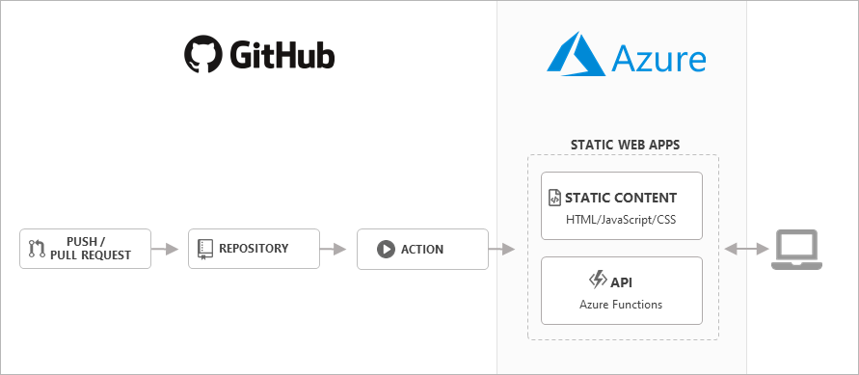
Goal: Integrate Public Transportation Data into App
Consumer:
Azure Static Web App
Requirement:
Data must be sent in WKT (Well-Known Text) format
GitHub Actions also allow for database deployment
Modern apps
Azure SQL Database
Catch the bus
Summary
What’s new
Notes:
A: As for deploying with Github, you can definitely do that. Azure Static Web Apps allow you to create sites in your language of preference, like Vue.js, and deploy the web app with an Azure Function. You can also use GitHub actions to deploy and manage your Azure SQL Database. Let me show you.

Slide 26
Catch the bus
Bus
IoT Device
JSON
Azure Functions
Azure Logic App
Notifications via Outlook/Gmail
TDS
JSON
Azure SQL
T-SQL
Azure Storage
Route Reference Data
Notes:
D: Azure SQL DB is really cool, pretty easy to manage. Supports JSON, Geospatial, as well as connecting to other services.
D: I put together a sample architecture for what I’m thinking Anna. *Explains the architecture*.
D: I like SQL DB. But I’m worried this is going to cost me a lot, especially just for me to use.

Slide 27



Catch the bus
Bus
IoT Device
JSON
GitHub Actions
Azure Functions
Azure Logic App
Notifications via Outlook/Gmail
WKT (Well-Known Text)
Web
TDS
JSON
Azure Static Web App
Azure Functions
Azure SQL
T-SQL
Azure Storage
Route Reference Data
Website for monitoring active buses
Notes:
D: Azure SQL DB is really cool, pretty easy to manage. Supports JSON, Geospatial, as well as connecting to other services.
D: I put together a sample architecture for what I’m thinking Anna. *Explains the architecture*.
D: I like SQL DB. But I’m worried this is going to cost me a lot, especially just for me to use.

Slide 28
Azure Static Web Apps and GitHub integrations
Demo
Notes:
A: Azure Functions how to connect to Azure SQL
Stored Procedure -> ShowBusData
Website
Show GitHub source (from portal blade)
Mention Azure SQL GitHub Action

Slide 29
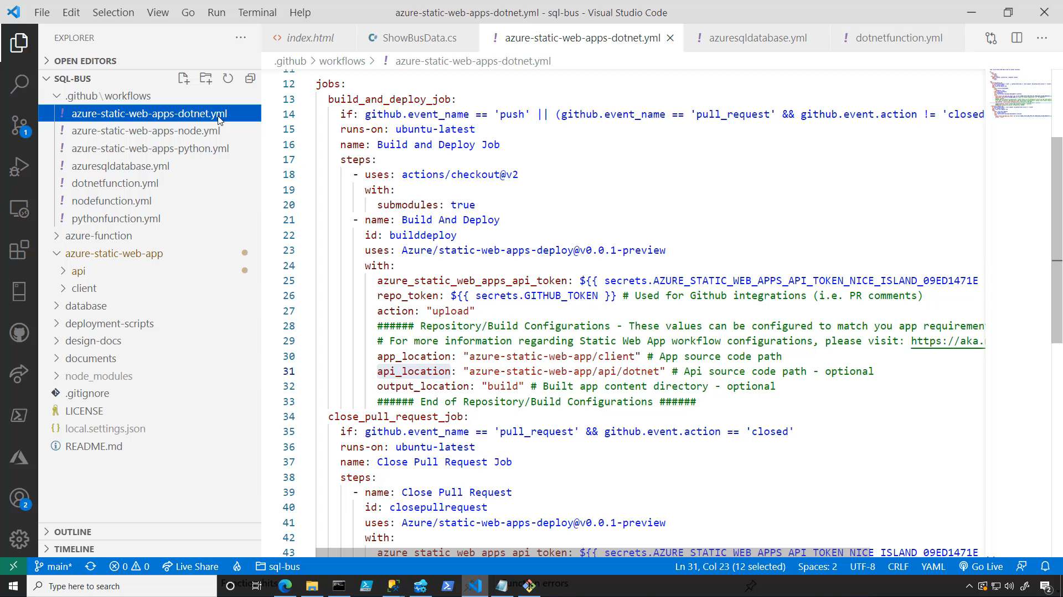
Azure Static Web Apps and GitHub integrations
Demo
Notes:
A: Azure Functions how to connect to Azure SQL
Stored Procedure -> ShowBusData
Website
Show GitHub source (from portal blade)
Mention Azure SQL GitHub Action

Slide 30
Azure Static Web Apps and GitHub integrations
Demo
Notes:
A: Azure Functions how to connect to Azure SQL
Stored Procedure -> ShowBusData
Website
Show GitHub source (from portal blade)
Mention Azure SQL GitHub Action

Slide 31
Catch the bus
Bus
IoT Device
JSON
GitHub Actions
Azure Functions
Azure Logic App
Notifications via Outlook/Gmail
WKT (Well-Known Text)
Web
TDS
JSON
Azure Static Web App
Azure Functions
Azure SQL
T-SQL
Azure Storage
Route Reference Data
Website for monitoring active buses
Notes:
D: Azure SQL DB is really cool, pretty easy to manage. Supports JSON, Geospatial, as well as connecting to other services.
D: I put together a sample architecture for what I’m thinking Anna. *Explains the architecture*.
D: I like SQL DB. But I’m worried this is going to cost me a lot, especially just for me to use.

Slide 32








Azure SQL
Ideal to support a large range of scenarios
Online Transaction Processing
Hybrid Transactional Analytics Processing
Streaming At Scale
Near-Real Time Analytics
Resources
https://aka.ms/azuresqlyt
https://aka.ms/catchthebus
tw: @AzureSQL
tw: @AnalyticAnna
Mobile
IoT
Gaming
Web & API
Retail & E-Commerce
Serverless
AI, ML & Recommenders
Notes:
A: I wanted to share some resources with you. I stream live every Wednesday on our YouTube channel, and there are lots of other videos for you to learn more. There’s even a playlist from Davide that explores some of these developer topics.
D: Thanks, Anna. *Anna no longer in view* You’ve really helped me understand how Azure SQL DB is ideal for a large range of scenarios, *expands a bit*
D: *Notification pops on screen showing Davide’s phone* Oh you know what, I just got a notification that my bus has entered the geo-fence, gotta run! *waves and walks away*

